Slide 1
Assessing and Implementing Supervised Machine Learning for Effective Customer Churn Prediction
Khanh Tran

Slide 2
Presentation Outline
Introduction
Background
Methodologies
Exploratory Data Analysis
Data Preparation
Model Building
Model Evaluation
Model Deployment
5. Results
6. Discussion & Conclusions

Slide 3
Presentation Outline
Introduction
Background
Methodologies
Exploratory Data Analysis
Data Preparation
Model Building
Model Evaluation
Model Deployment
5. Results
6. Discussion & Conclusions

Slide 4
Introduction
Telecommunication is a very competitive business sector.
Availability of enormous amounts of customer data through large-scale databases and digital platforms.
Rapid development of many machine learning algorithms.
Many corporations have applied machine learning to predict customer churn

Slide 5
Introduction
Project Objectives:
This research aims to determine the main factors that lead to customer churn by analyzing customer data and identifying trends.
The research will propose strategies to boost client retention.
Create reliable machine learning models for predicting customer churn, which is a strong tool for proactive churn control.

Slide 6
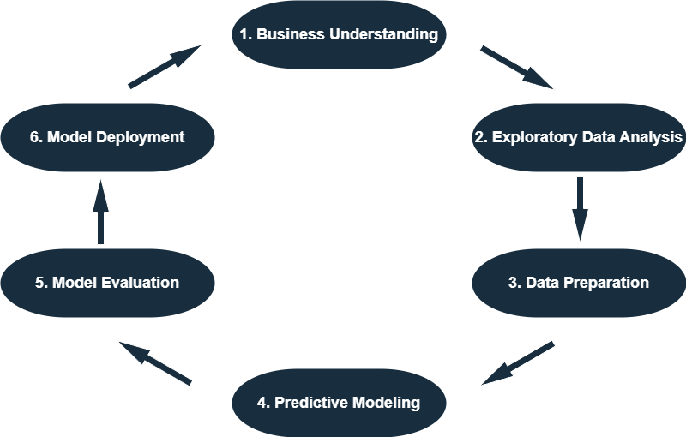
Introduction
To address these research goals, I will implement a thorough full life-cycle of data science approach to understand customer churn and create successful retention tactics.

Slide 7
Presentation Outline
Introduction
Background
Methodologies
Exploratory Data Analysis
Data Preparation
Model Building
Model Evaluation
Model Deployment
5. Results
6. Discussion & Conclusions

Slide 8
Background
Qureshi et al. (2013) used logistic regression, decision trees, and artificial neural networks to predict potential churners for the Customer DNA website dataset. He found that the decision trees were the best classifiers for identifying potential churners on this dataset.
Sisodia et al. (2017) used five machine learning algorithms—linear SVM, decision tree, random forest, k-nearest neighbor, and naive Bayes classifier—to build a model for predicting the churn rate for an HR analytics dataset. The authors evaluated the correlation between attributes, generated a histogram to contrast left employees with various factors, and proposed strategies to optimize employee attrition in organizations.

Slide 9
Background (cont.)
Ahmad et al. (2019) developed a churn prediction model using a dataset from SyriaTel telecom company, which includes customer information over nine months. The authors experimented with several ML algorithms, and they found that the XGBoost algorithm had the best results with an AUC score of 93.3%.
Lalwani et al. (2022) applied various predictive models such as logistic regression, naive bayes, support vector machine, random forest, decision trees, boosting, and ensemble techniques. The paper also discusses the use of K-fold cross-validation for hyperparameter tuning and preventing overfitting. The results show that Adaboost and XGBoost classifiers achieve the highest accuracy of 81.71% and 80.8%, respectively.

Slide 10
Background (cont.)
Geiler et al. (2022) focused on churn prediction in businesses and explored the performance of various supervised and semi-supervised learning methods and sampling approaches on publicly available datasets. The study suggests an ensemble approach should be used for churn prediction.
Observation: Numerous papers on customer churn prediction, many focus only on models’ performance comparison and enhancement. There is a notable gap in the literature regarding the practical application of machine learning techniques in this churn prediction area.
This study aims to bridge this gap by providing a comprehensive analysis of the practical implementation of machine learning in churn prediction, thereby contributing to the advancement of the field in a more applied manner.

Slide 11
Presentation Outline
Introduction
Background
Methodologies
Exploratory Data Analysis
Data Preparation
Model Building
Model Evaluation
Model Deployment
5. Results
6. Discussion & Conclusions

Slide 12
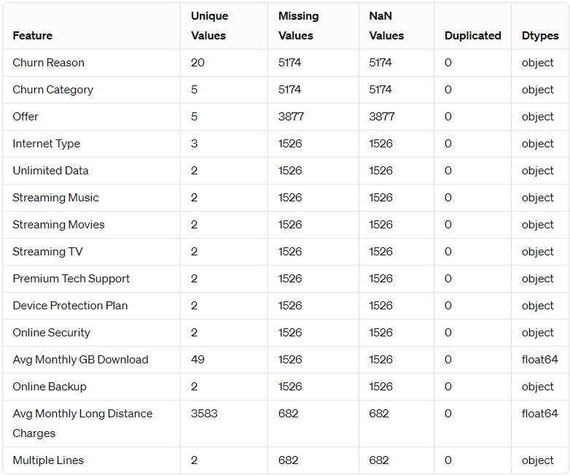
Exploratory Data Analysis
Telecom Customer Churn dataset:
7043 observations
37 explanatory variables
01 target variable, Customer Status

Slide 13
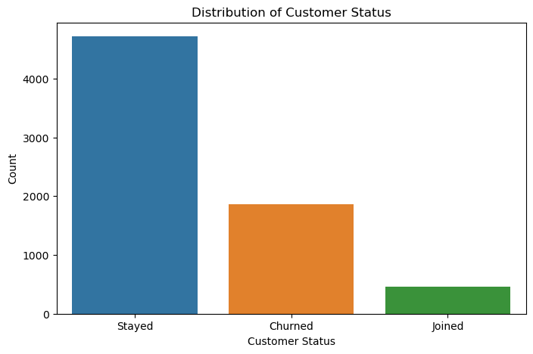
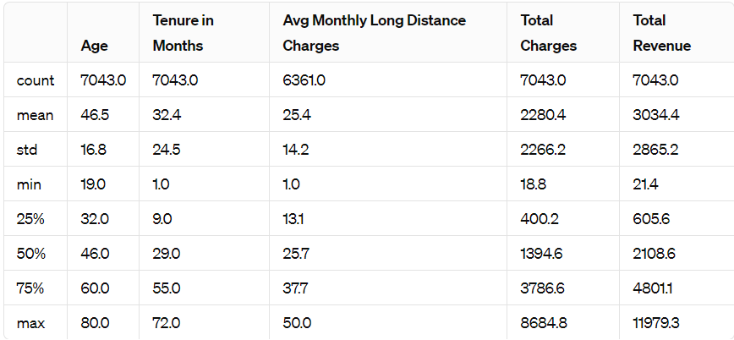
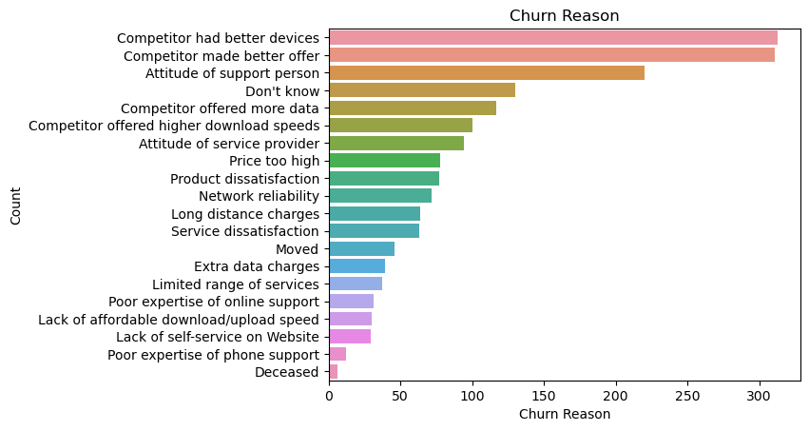
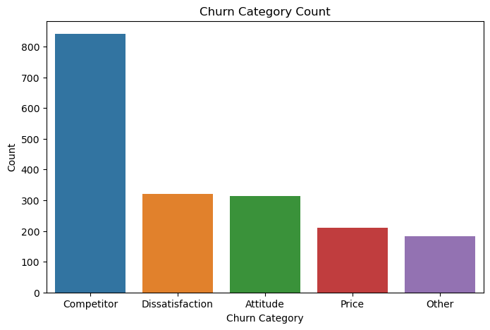
Exploratory Data Analysis

Slide 14
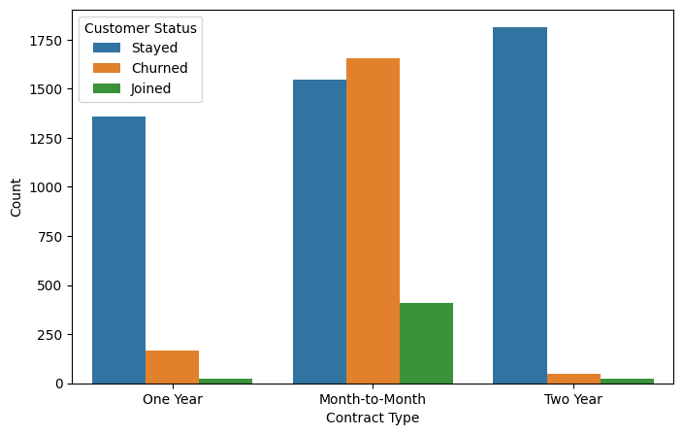
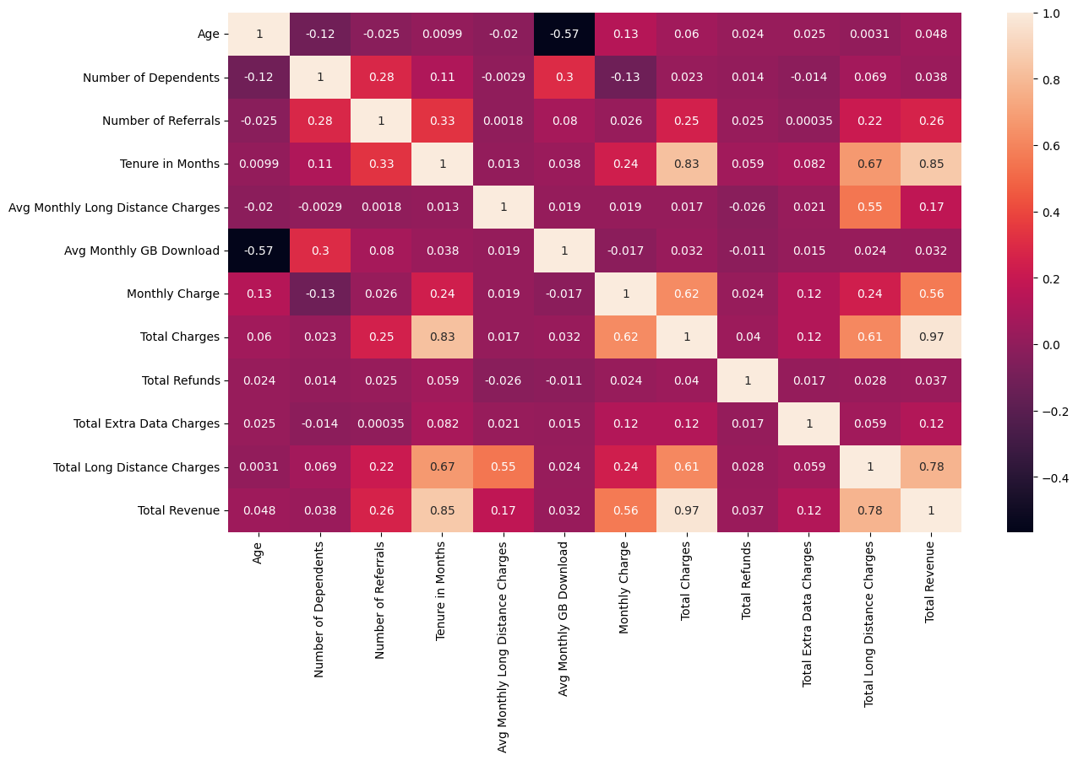
Exploratory Data Analysis

Slide 15
Data Preparation
The original dataset was stratified split into 75% for train and 25% for test set
Some non-informative or directed churn-related columns were removed, like CustomerID, Churn reason
Categorical missing data were filled by “NO”
Numerical missing data were filled by 2
MinMax scaling was applied for numerical features
Binary categorical features were mapped to 0 and 1
Remaining categorical variables were applied one-hot encoder

Slide 16
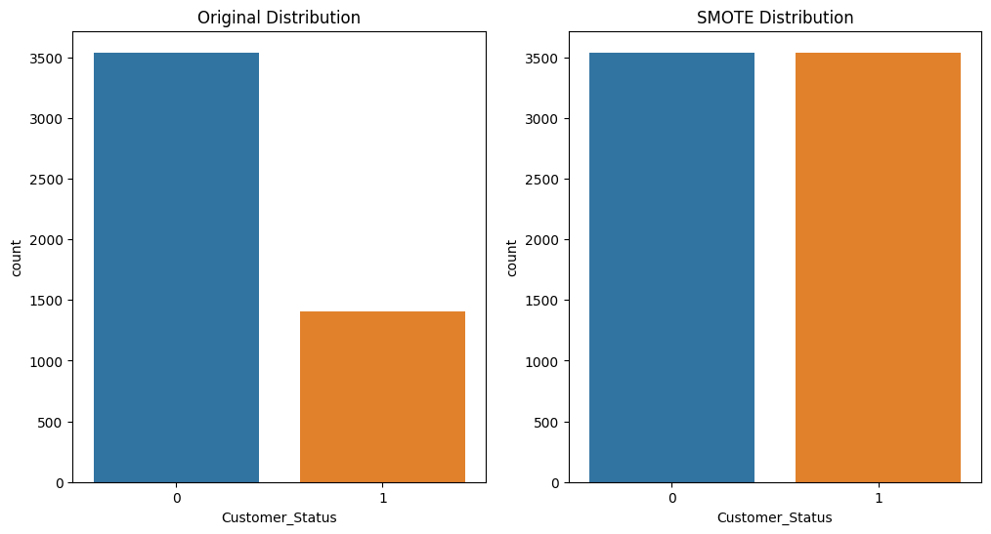
Data Preparation
Apply SMOTE

Slide 17
Model Building
# Initialize models
models = {
"Logistic Regression": LogisticRegression(random_state=6910),
"SVC": SVC(random_state=6910),
"KNeighbors Classifier": KNeighborsClassifier(),
"GaussianNB": GaussianNB(),
"Decision Tree": DecisionTreeClassifier(random_state=6910),
"Random Forest": RandomForestClassifier(random_state=6910),
"Gradient Boosting": GradientBoostingClassifier(random_state=6910),
"AdaBoost Classifier": AdaBoostClassifier(random_state=6910),
"Bagging Classifier": BaggingClassifier(random_state=6910),
"MLP Classifier": MLPClassifier(random_state=6910),
“XGboost": XGBClassifier(random_state=6910),
“Lightgbm": LGBMClassifier(random_state=6910, verbose=-1)
}

Slide 18
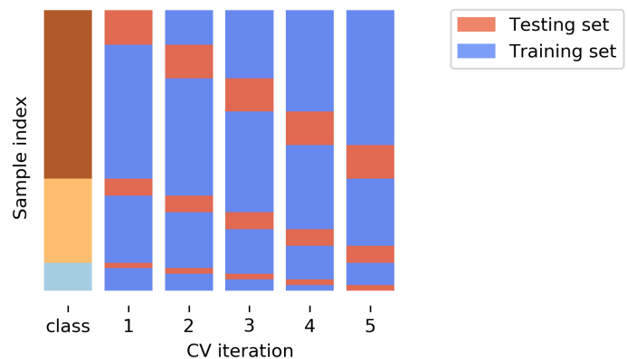
Model Evaluation
Models’ performances were evaluated by using stratified 5-fold cross-validation
Test model performance on unseen test set
Similar evaluation was done on SMOTE training set
Pedregosa et al., 2011

Slide 19
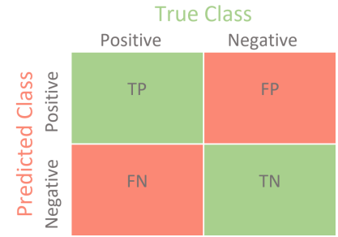
Model Evaluation
Derived metrics from the Confusion Matrix were used for evaluation: accuracy, Precision, Recall, and F1 Score
GridSearchCV and RandomizeSearchCV was applied to fine-tune models
Brian, 2020

Slide 20
Model Deployment
Model Serialization: - save the final model to the pickle file
Scoring scrip in "score.py" file
Create Azure resources
Deploy the model
Register the model in Azure Machine Learning
Create a Conda environment for the model
Create an InferenceConfig
Specify deployment configuration for ACI
Deploy model
Get the service endpoint
James et al., 2013

Slide 21
Presentation Outline
Introduction
Background
Methodologies
Exploratory Data Analysis
Data Preparation
Model Building
Model Evaluation
Model Deployment
5. Results
6. Discussion & Conclusions

Slide 22
Results
Reasons for churn: competitors, dissatisfaction, attitude, price, and others, implying that competitors having an attractive offer and better service delivery is the common cause of churn
Month-to-month contracts customers tend to churn
Moderately negative correlation between average monthly GB downloads and age (-0.57) indicates a lower number of downloads among 31 the elderly

Slide 23
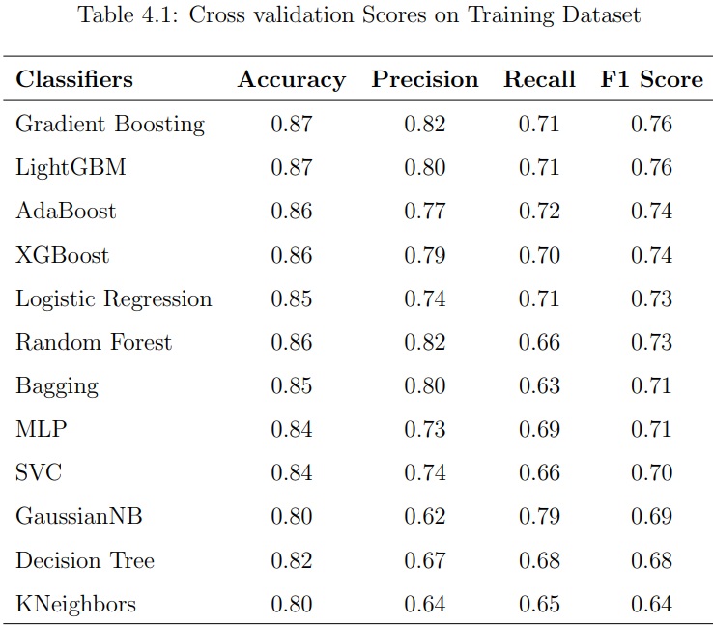
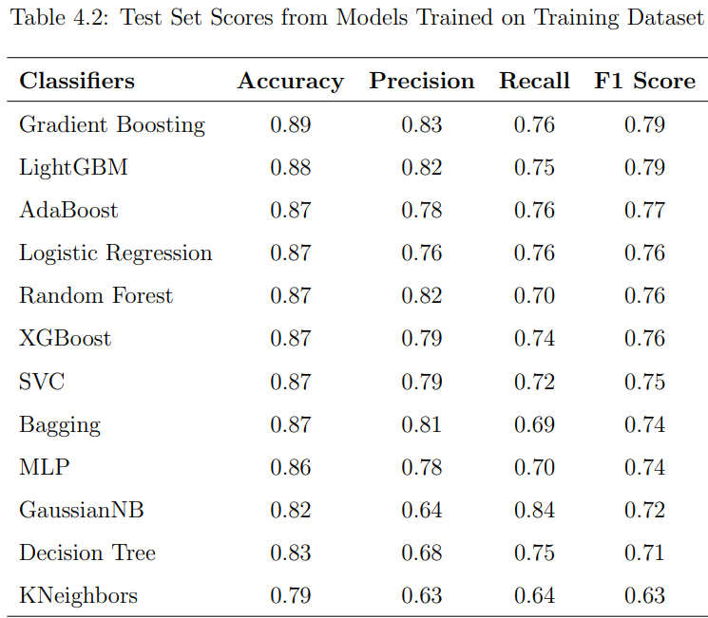
Results

Slide 24
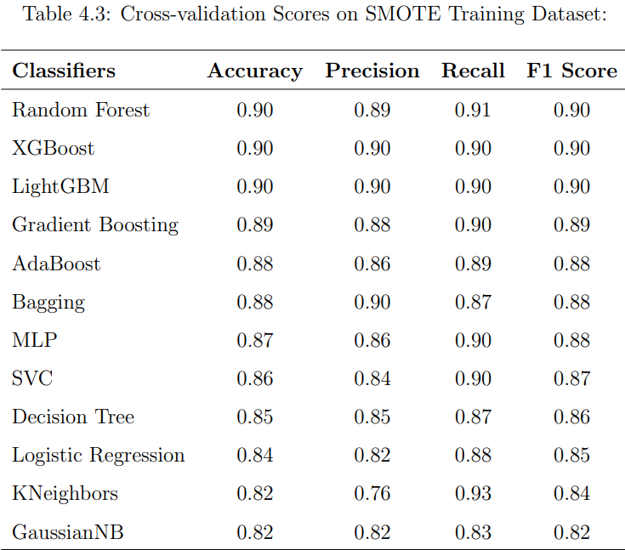
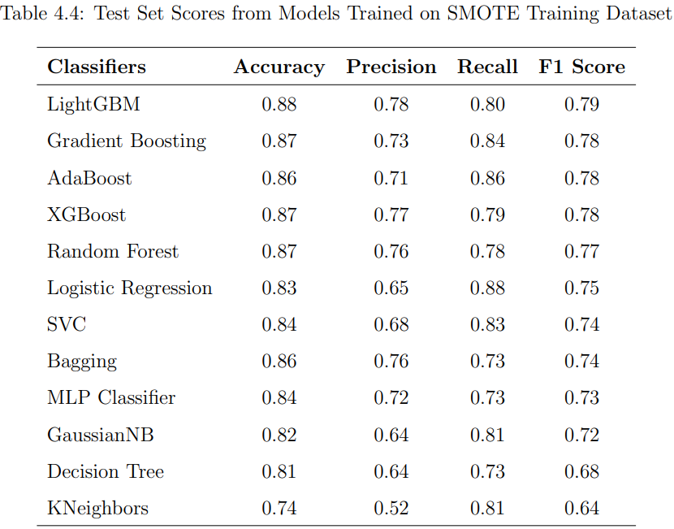
Results

Slide 25
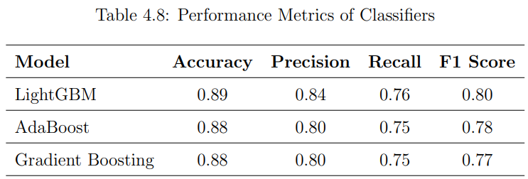
Results
Test Score of fine-tuning models:

Slide 26
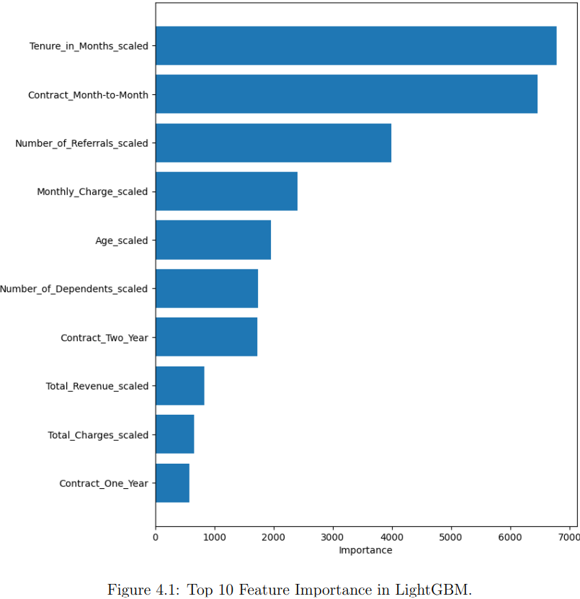
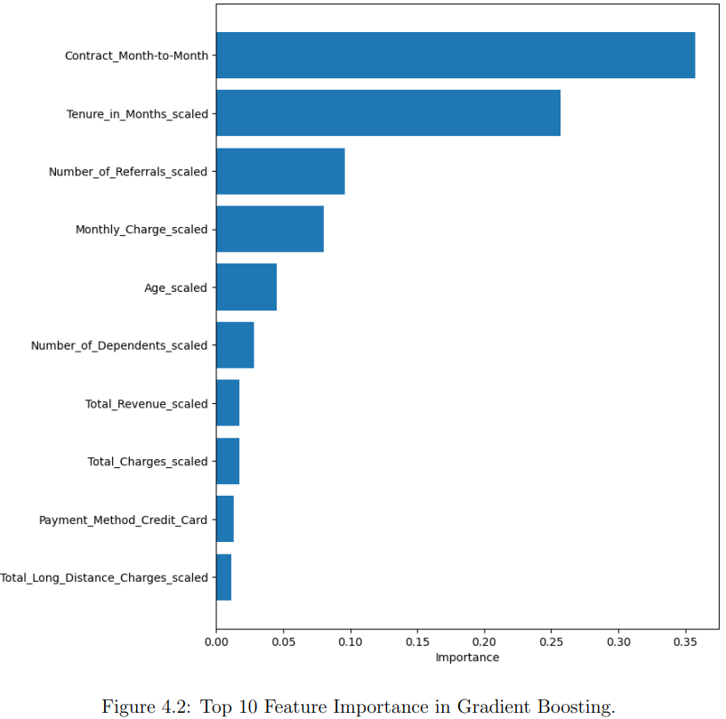
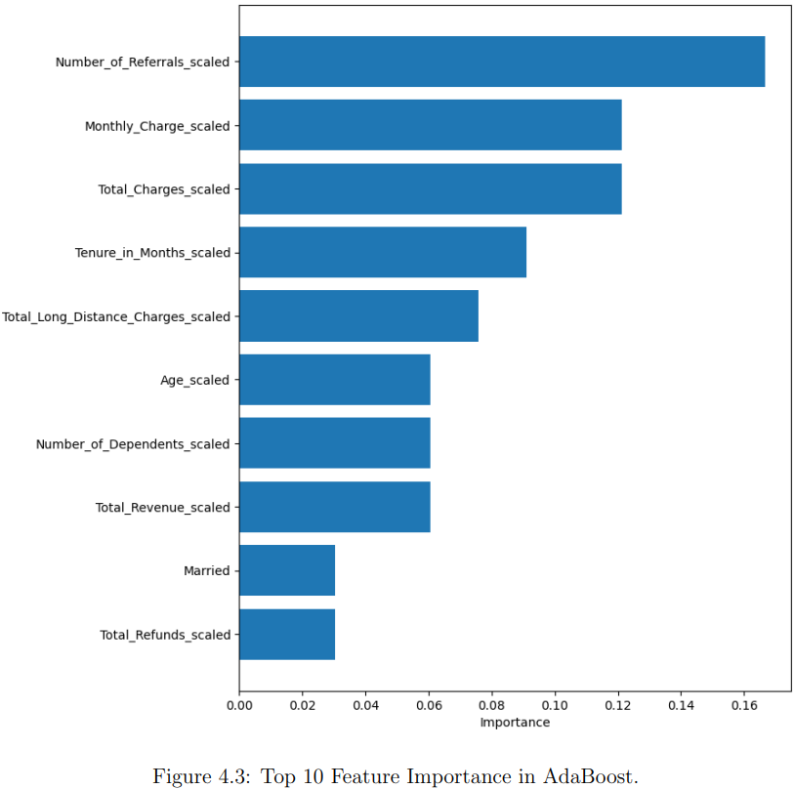
Results

Slide 27
Presentation Outline
Introduction
Background
Methodologies
Exploratory Data Analysis
Data Preparation
Model Building
Model Evaluation
Model Deployment
5. Results
6. Discussion & Conclusions

Slide 28
Discussion & Conclusions Implications for Corporation:
Contractual Adjustments: Findings point to the different implications of month-to-month versus long-term contracts on customer loyalty. Practitioners can use this data to design contracts that better serve customer preferences and foster long-term loyalty.
Referral Programs: The AdaBoost model, in particular, showcased the influence of referral programs on customer retention. This implies that encouraging existing customers to make referrals can be an effective strategy for enhancing the customer base and reducing churn.
Pricing and Billing Strategies: Ensemble methods have demonstrated the predictive importance of billing-related features. This insight can inform practitioners to revise their pricing strategies to balance affordability and service value, aiming to reduce churn rates associated with billing concerns.

Slide 29
Discussion & Conclusions Implications for Corporation:
Product and Service Development: The importance of specific features like Total Long Distance Charges suggests that service usage patterns are key in predicting churn. This can direct product development teams to create services that more accurately meet customer needs, potentially reducing the incentive to churn.
Retention Campaigns: By understanding the drivers behind churn, marketing teams can tailor retention campaigns more effectively, focusing on the areas most likely to influence customer decisions to stay.
Predictive Customer Support: Deploying the final model into a production environment enables real-time prediction of customer churn. This can be particularly useful for customer support teams, as they could receive alerts about customers who might be at risk of churning, prompting timely intervention.

Slide 30
Discussion & Conclusions Contributions
The study showcases the effectiveness of different supervised machine learning models, namely ensemble techniques in accurately forecasting customer attrition. This contributes to the increasing amount of evidence that machine learning offers a strong analytical foundation for dealing with churn.
The research offers valuable insights into the primary aspects that contribute to churn, including the duration of customer retention, the types of contracts, the number of referrals, and the amount of invoicing. This contributes to our comprehension of consumer behavior and assists in the creation of focused retention efforts.
The study demonstrates the potential for real-time churn prediction by implementing the final LightGBM model in a production scenario on the Azure Cloud. This enables firms to promptly identify potential customers who are likely to stop using their services and take proactive actions to keep them.

Slide 31
Discussion & Conclusions Contributions
The research showcases the integration of complex prediction models with smart business methods, emphasizing the harmonious relationship between data science and business operations. This facilitates the implementation of better-informed decision-making and more effective churn management measures.
This study adds to the body of academic literature on churn prediction by showing that ensemble approaches work in a real-world telecoms dataset. This might function as a point of reference for future research on the topic.

